Slide 1
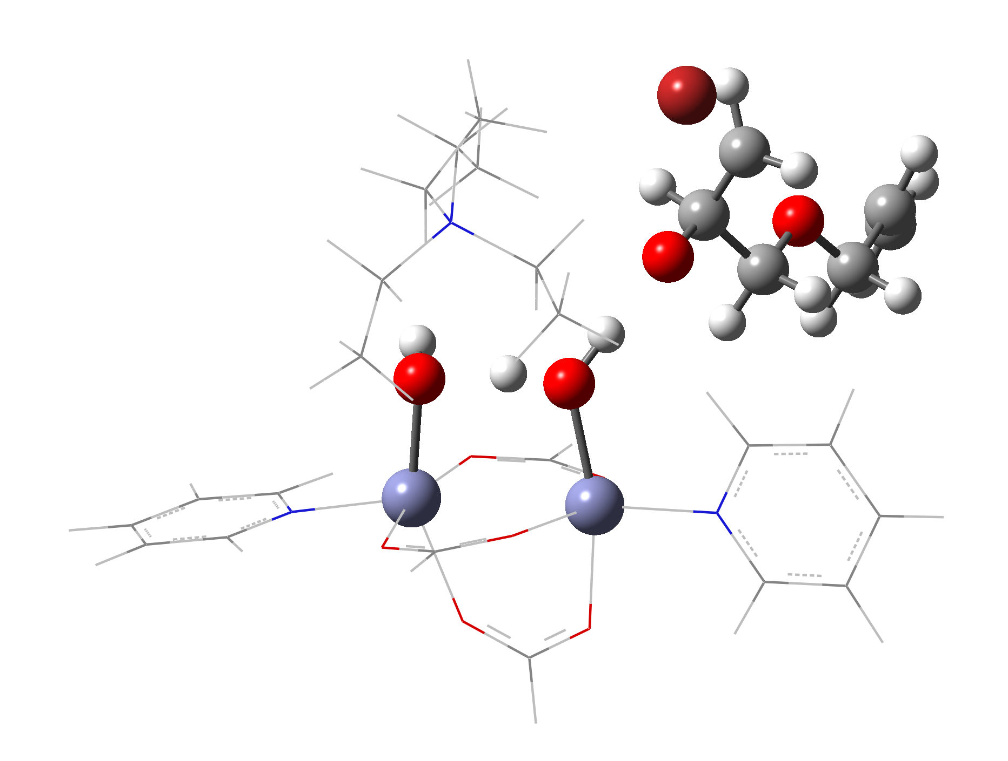
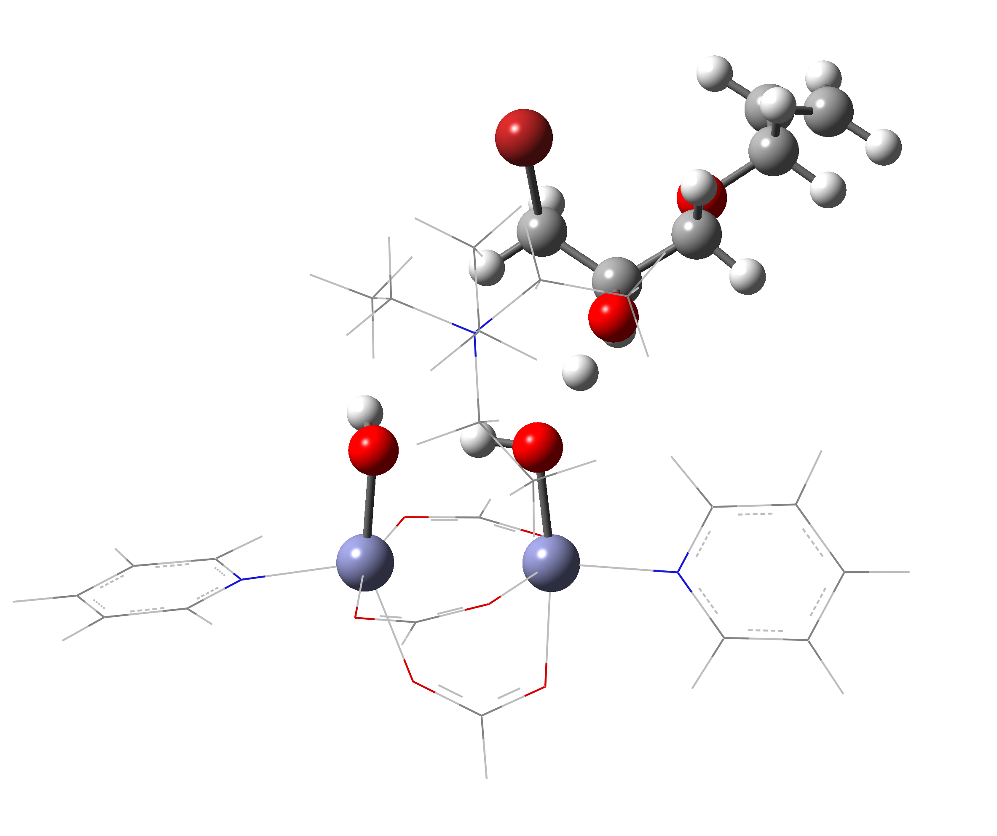
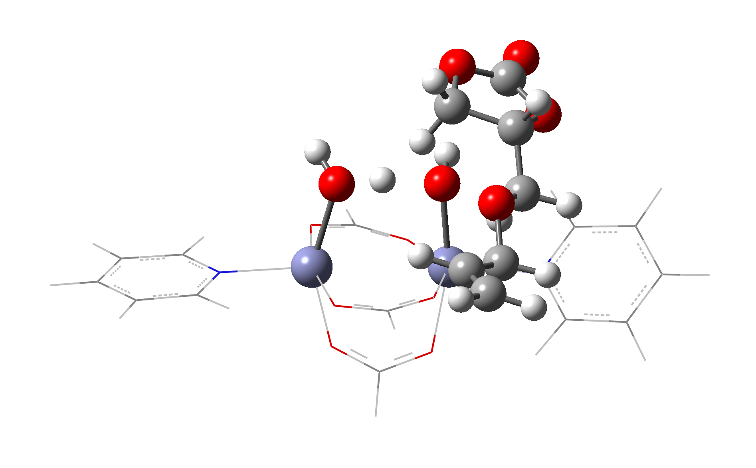
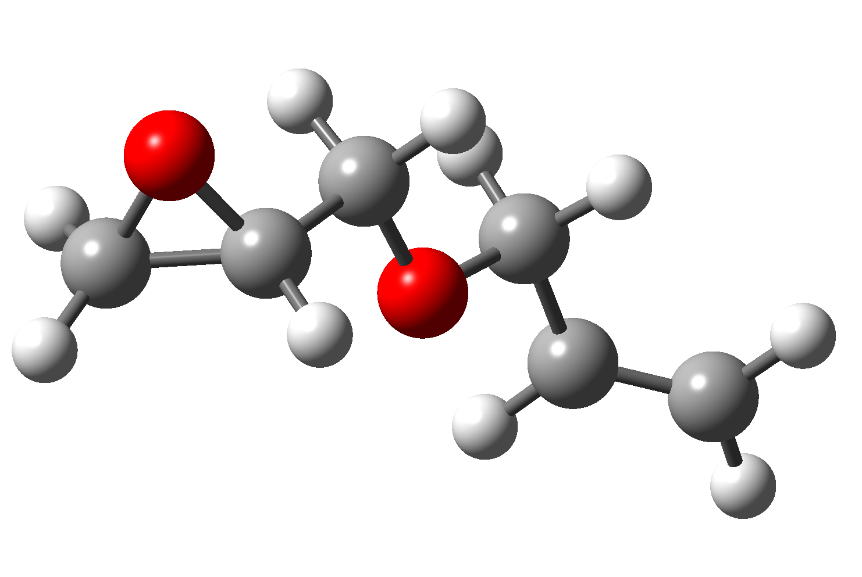
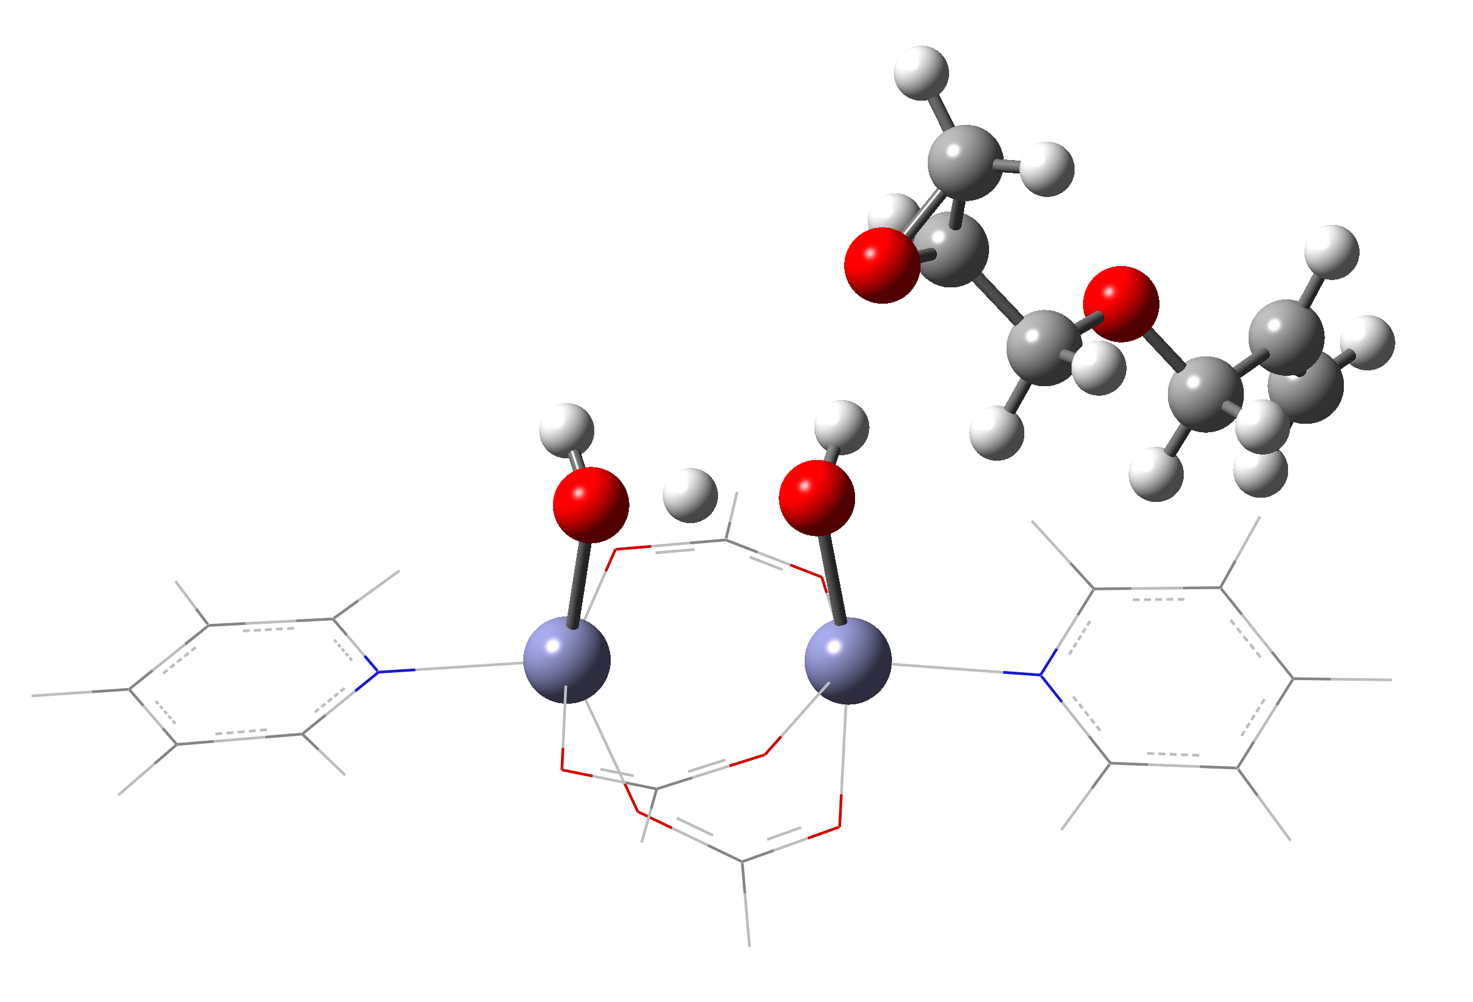
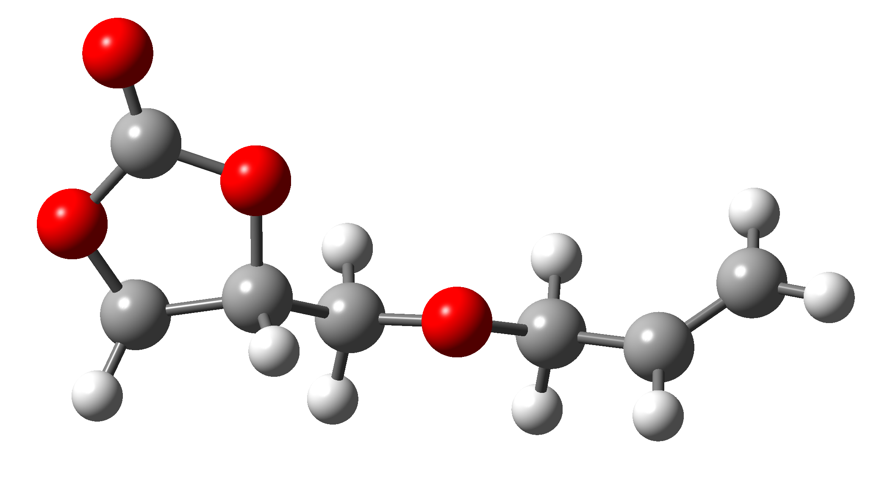
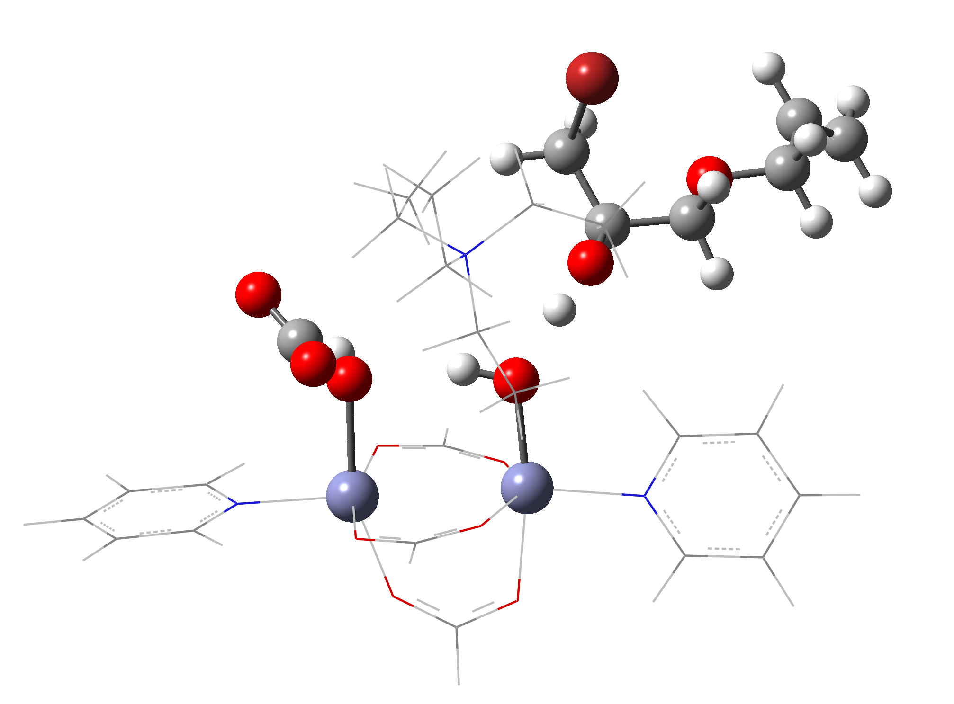
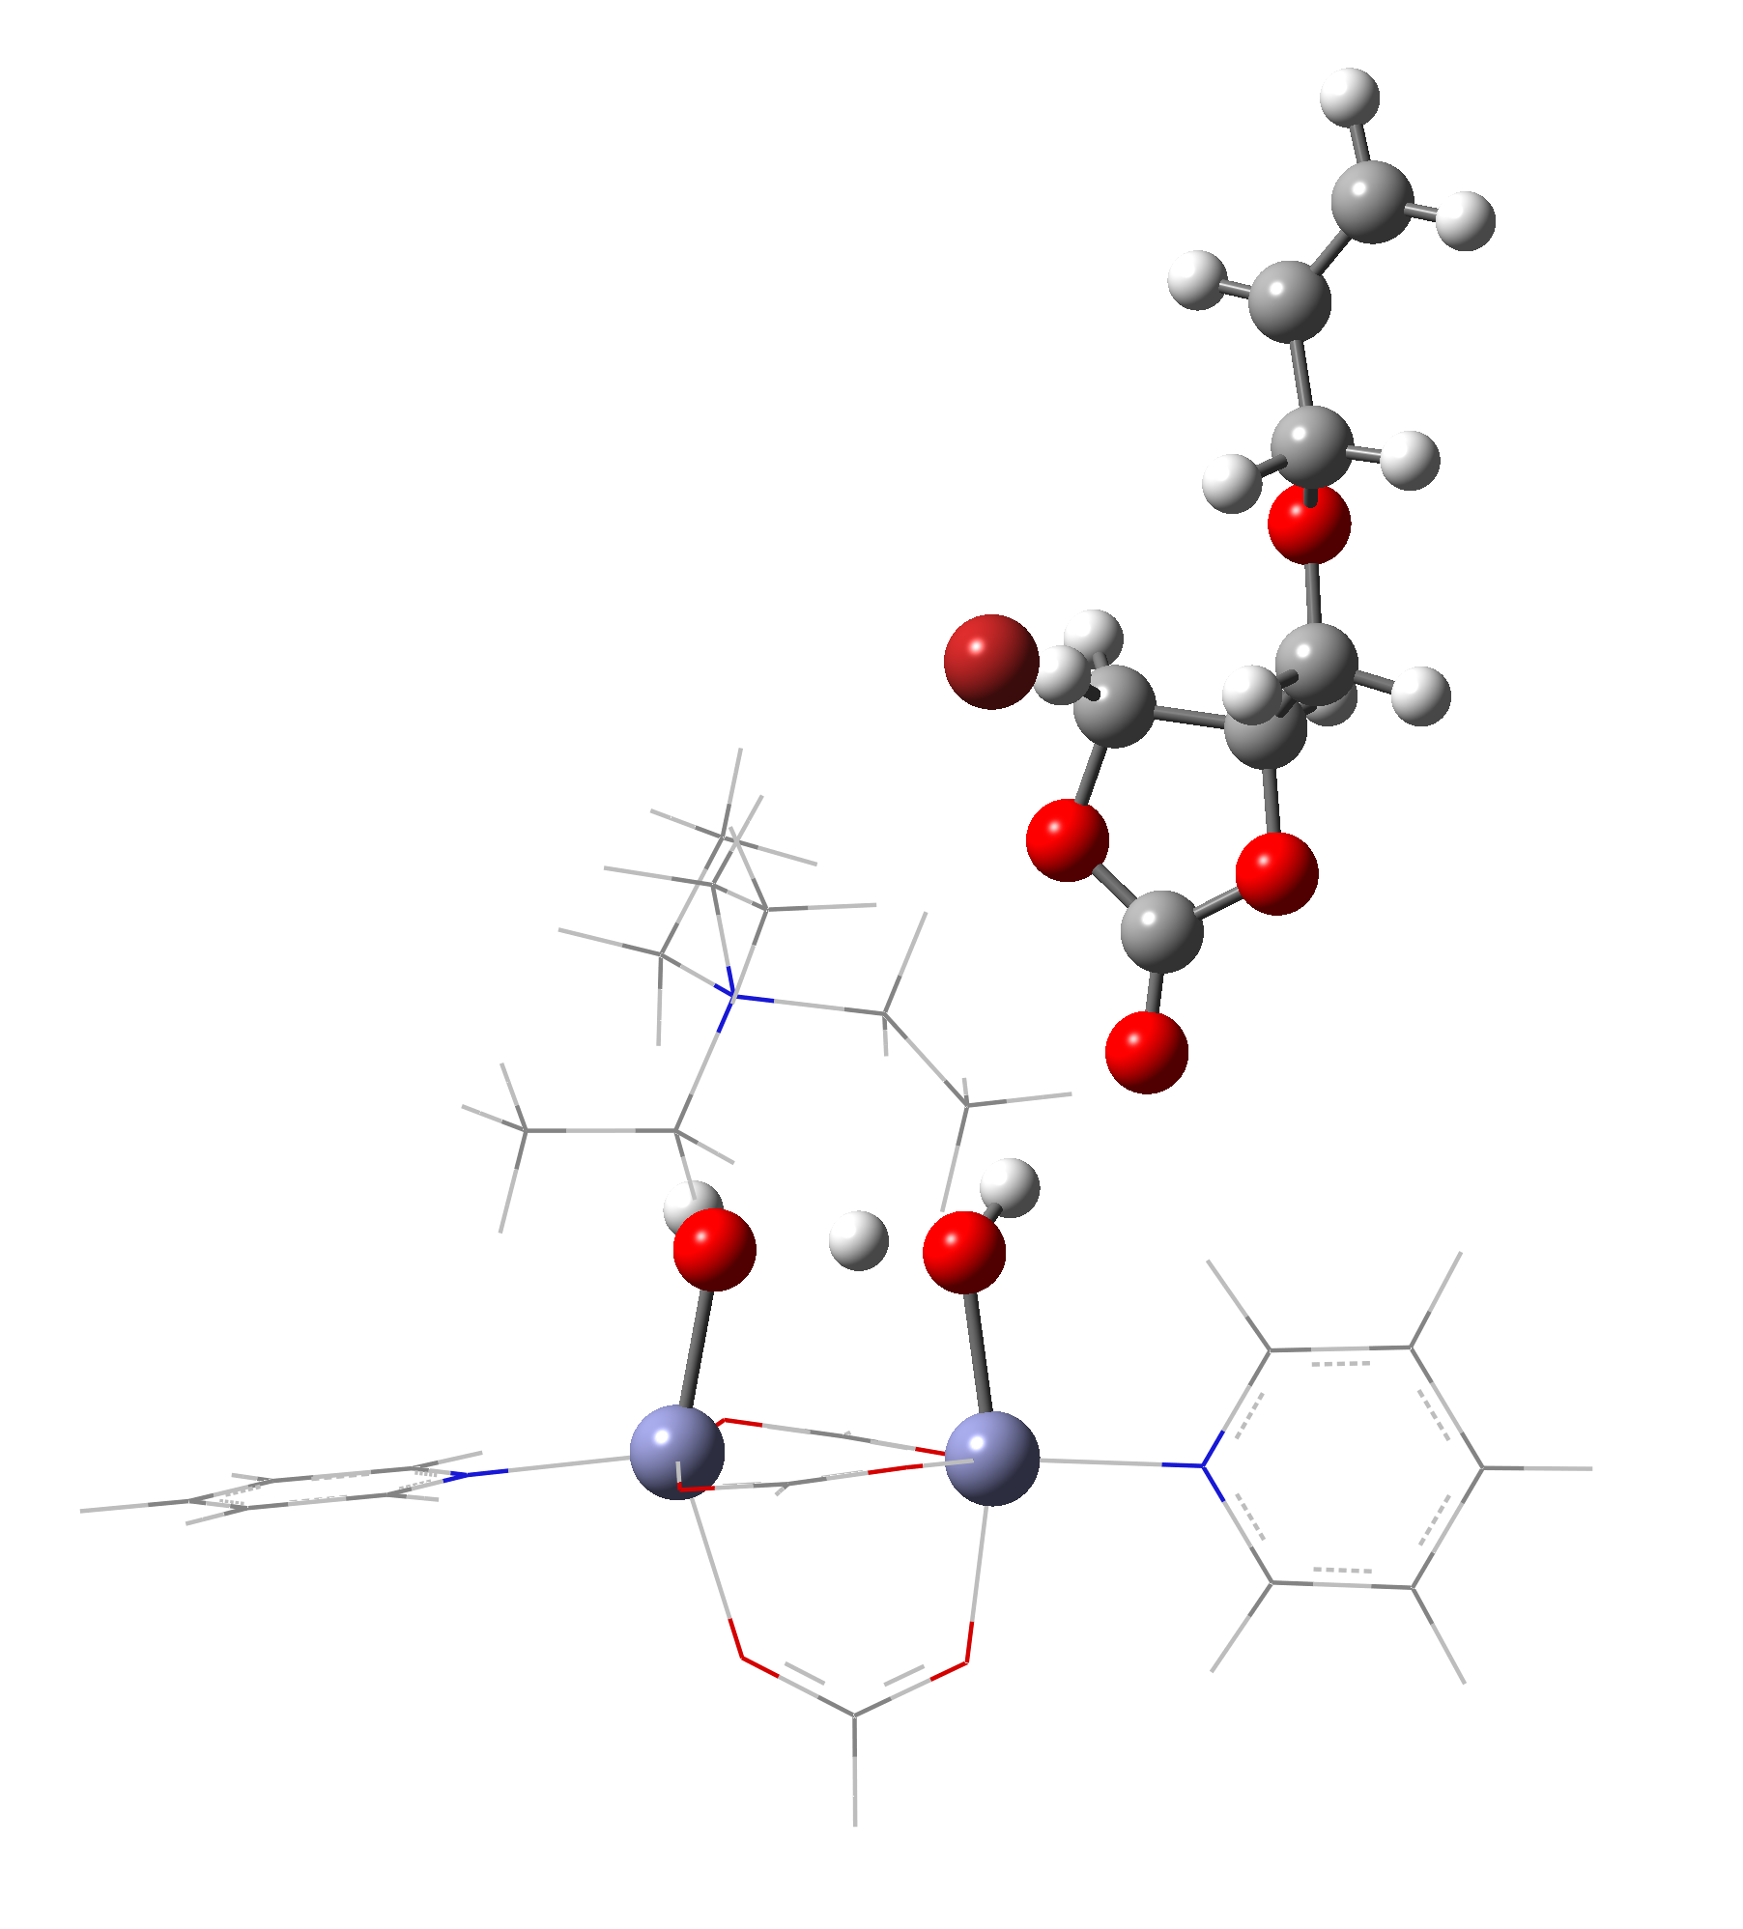
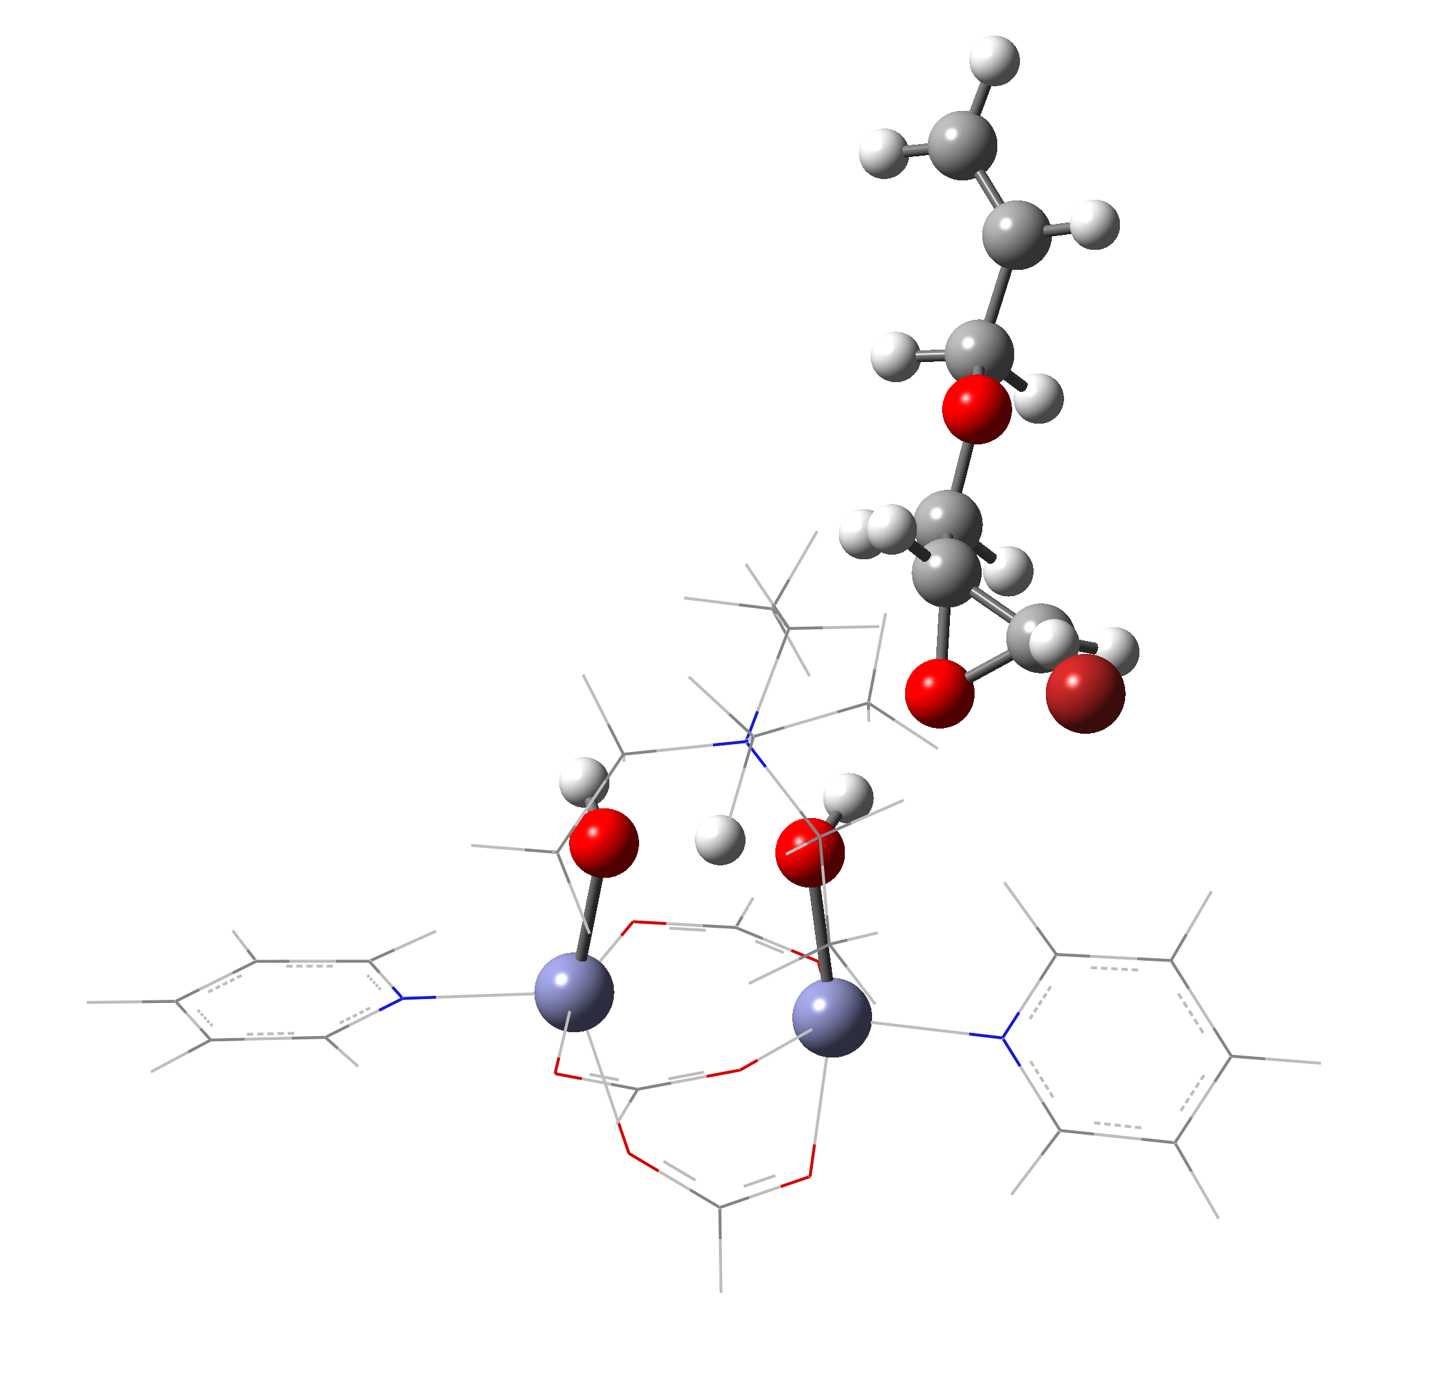
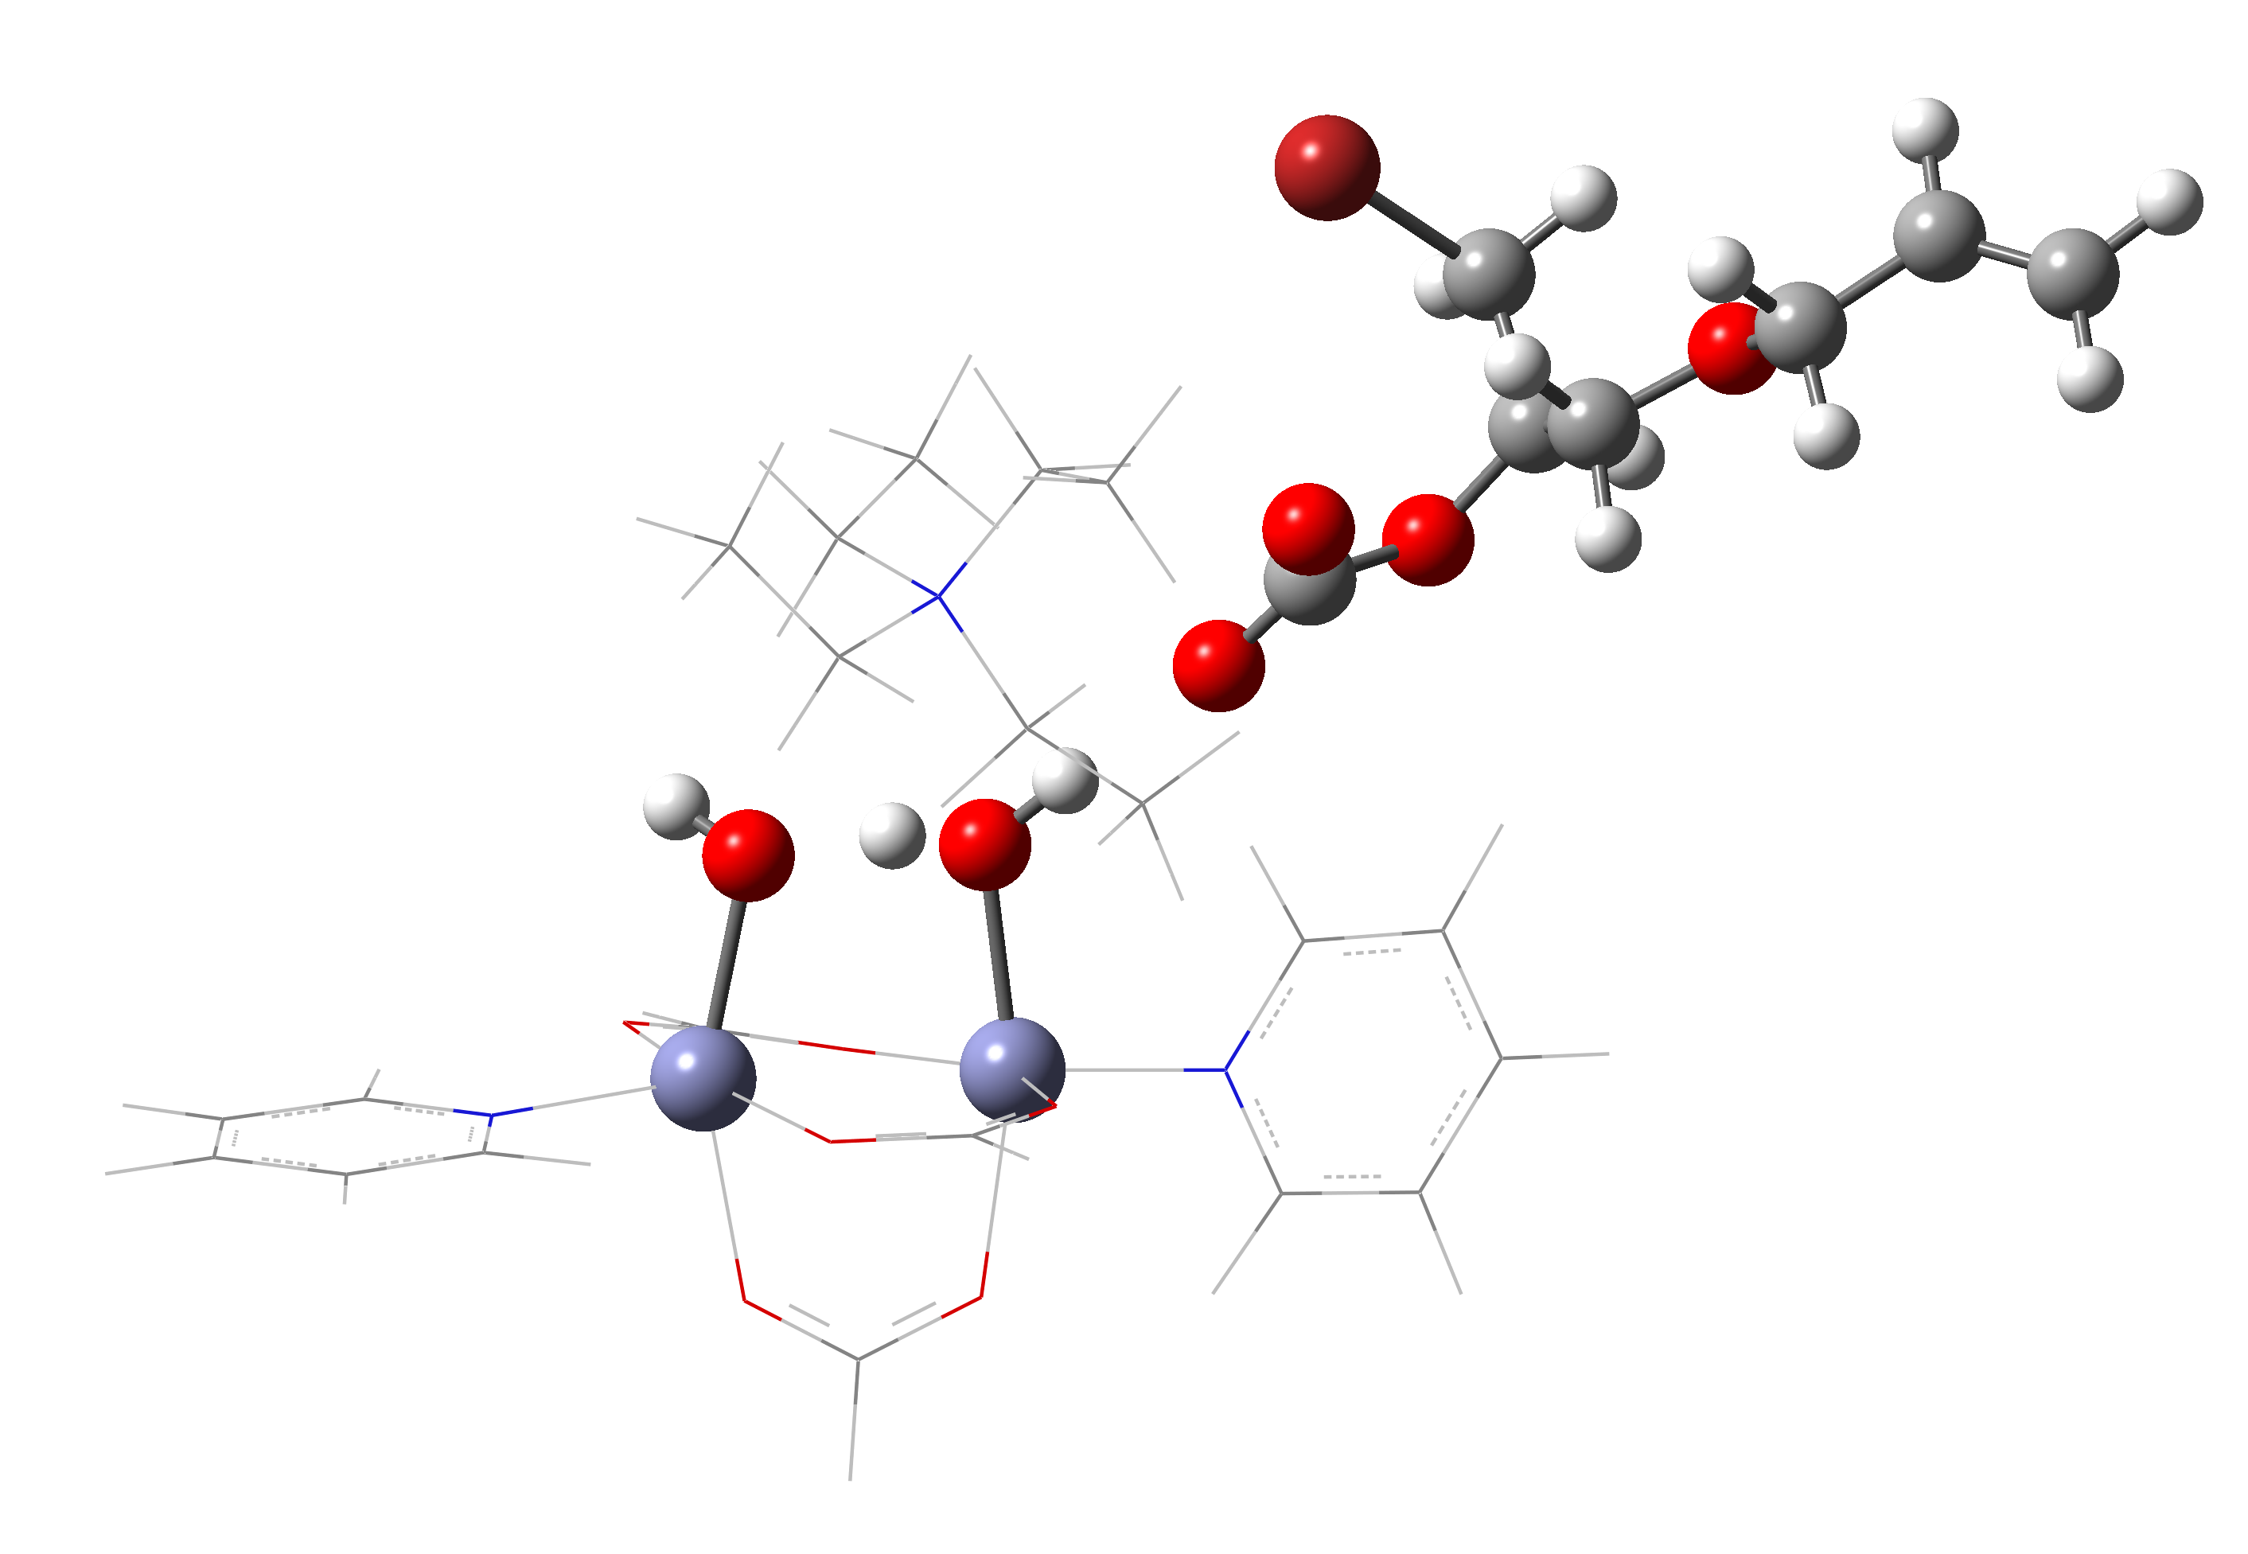








‡
21.6
TS
TS
0.0
$−$1.4
AGE
Int1
AGE
Int3
Int7
$−$11.8
Int3
$−$15.9
$−$19.0
$−$20.5
AGC
ΔE (kcal/mol)
Int2
Int4
$−$22.7
AGC
$−$25.4
Int7
Int5
Int1
$−$41.4
Int6
Int4
Int2
Int6
Int5
Reaction Coordinate

